Slide 1



Break Through Tech Miami
SMART
PARKING FIU
PantherSoft
PRESENTED BY:
Omer Matin
Ousman Bah

Slide 2

03 | Problem Overview
04 | Proposed solution
05 | Tech Stack
06 | App Workflow
07 | Data Flow
08 | AI Implementation
09 | UI Design
10 | Challenges faced

Slide 3

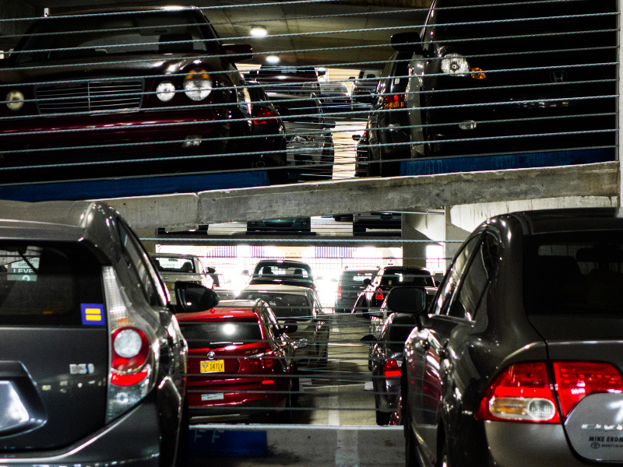
Underutilized data – Parking data isn’t connected to student’s class schedule or location.
No personalized suggestions – Everyone sees the same garage list, regardless of where or when their classes are.
No smart filters – There’s no way to filter garages based on walking distance, availability, or how soon your class starts.
The Problem

Slide 4

Personalized recommendations – The app ranks garages based on your uniIue class schedule, location, and walking distance.
Connected data sources – It pulls real-time parking availability and automatically maps it to your in-person classes for today.
Proposed Solution
Smart filters built-in – . Results can be sorted by dIstance from user, dIstance from class, and avaIlabIlIty

Slide 5










Tech Stack
Dart
Flutter
Figma
Postman
App Workflow
Extract Data
Process data
Generate Recommendations
Suggest recommendatIons

Slide 6

Data Flow
Extraction:
Fetched garage, class schedule, and building data using FIU Parking API.
Handled nested JSON to isolate relevant fields (building, time, days, etc).
Processing
Filtered out non-relevant classes (e.g., online or future dates).
Mapped class building codes to physical coordinates.
Used GeoUtils in Flutter to calculate walking distance to each garage.
Combined garage metadata and schedule into a clean data model.

Slide 7
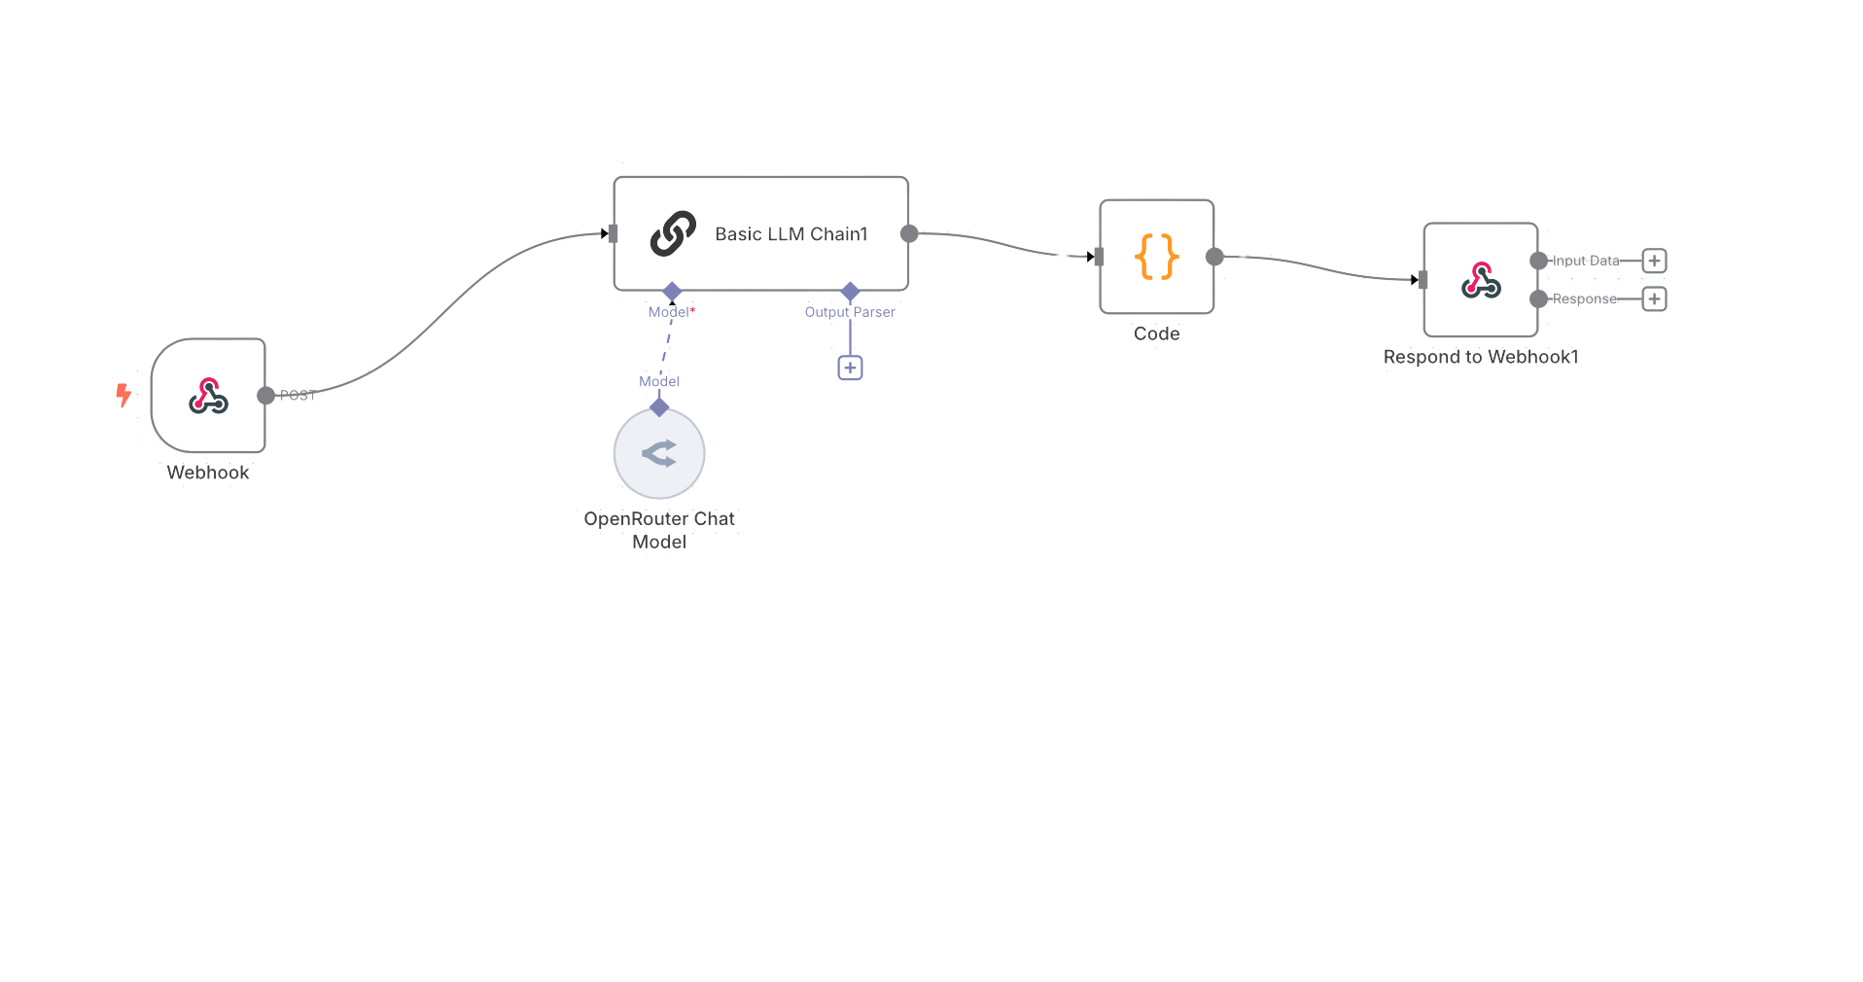
n8n Workflow
The core automation workflow for personalized parking recommendations.
Respond to Webhook
Sends parking suggestions to the app
Basic LLM
Generates personalized
recommendations
WEBHOOK
Receives data
Open Router Model
Initializes the LLM- LLAMA 4

Slide 8
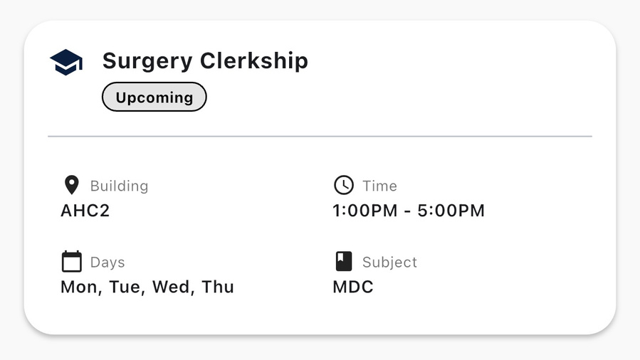
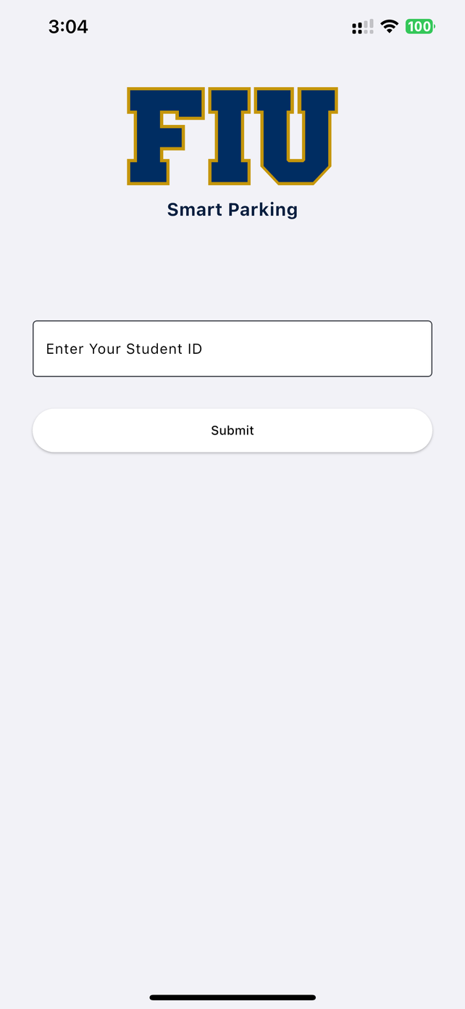
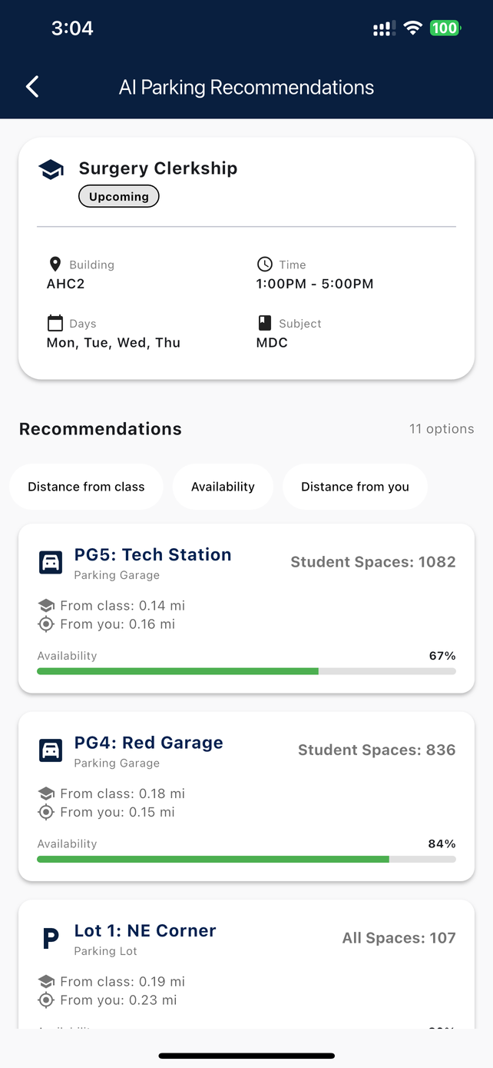
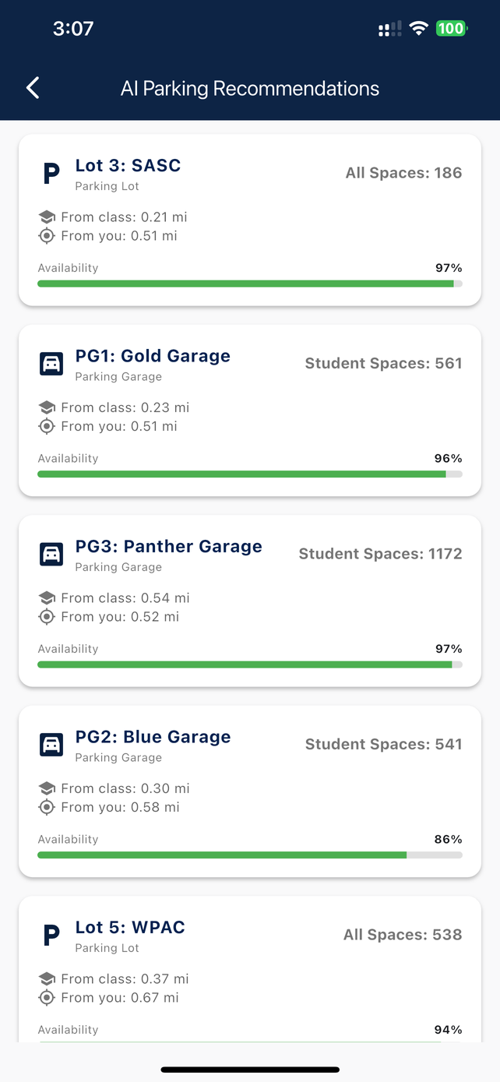
APP PREVIEW

Slide 9
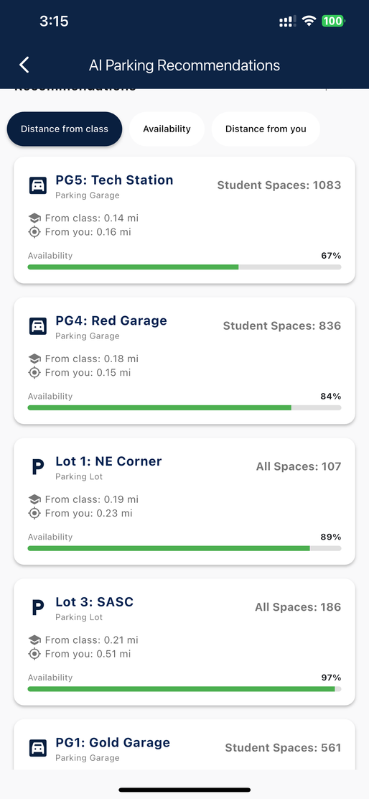
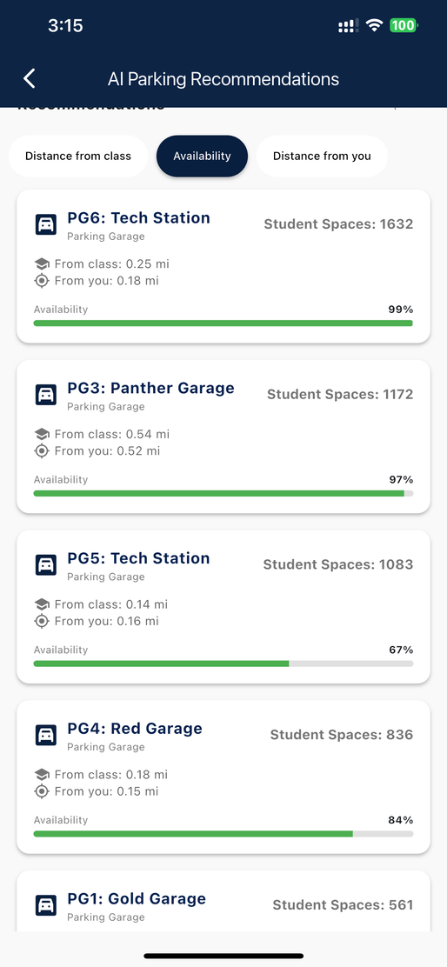
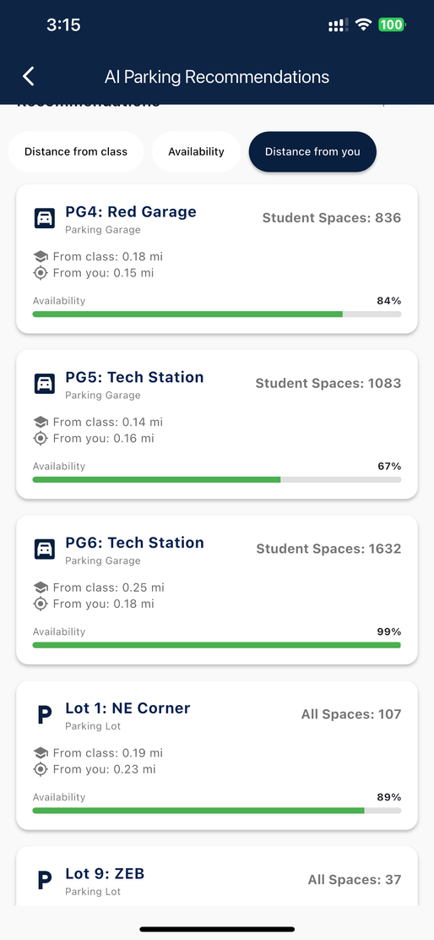
Custom FIlter Functionality
To Enchance user Functionality we added cutom filter options
Filter By Distance From class
Filter By Avaibality
Filter By Distance From user location

Slide 10
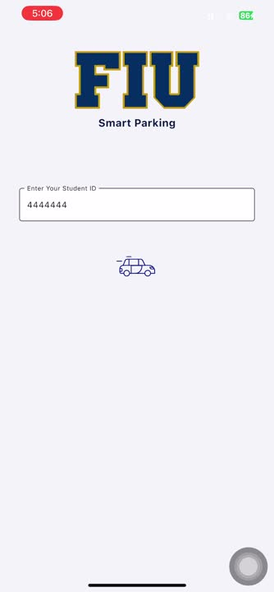
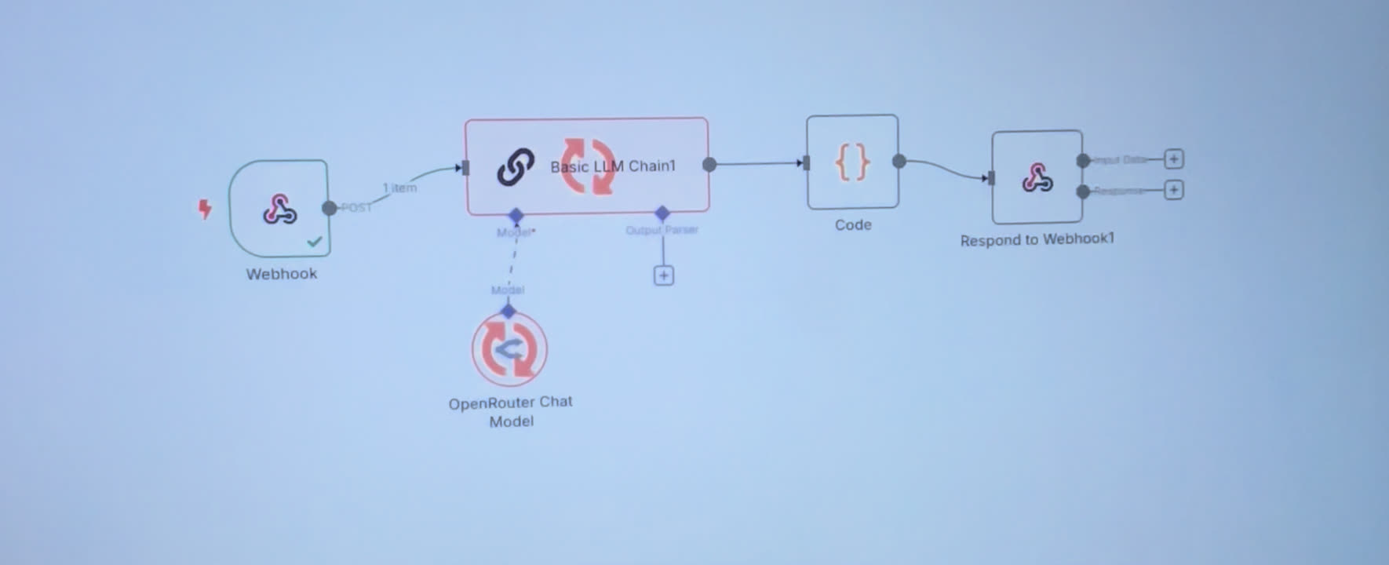
DEMO ON IPHONE

Slide 11
Learning Outcomes & Growth & Acknowledgments & Next Steps

